Slide 1
AB TEST ANALYSIS OF AN E-COMMERCE PRODUCT PAGE REDESIGN
Z-test, Chi-square test ,Time Intelligence, Claude a.i and Microsoft co-pilot
Prepared by Rachael Agunloko
Job Title : Data Analyst

Slide 2
INTRODUCTION
A fictional online retail store wanted to promote sales of their product by redesigning the product page.
The initial design (control group) is blue CTA, standard layout
The new design (test group) is green CTA + social proof.
The retail store ran a 4-week A/B test (6 Jan – 2 Feb 2025) to measure whether a redesigned product page increased purchases.

Slide 3
METHODOLOGY
The statistical tools deployed for the ab testing experiment were python, pandas, matplotlib and seaborn.
The primary metric is conversion rate
The secondary metric is total revenue generated in USD
Z-test was conducted to determine if conversion rate is statistically significant between the product pages.
Chi-Square test was conducted to evaluate significant association between gender, device type and traffic source.
Bar charts and line plots were deployed for visualisation.

Slide 4
RESULTS AND DISCUSSION
A. HYPOTHESIS TESTING
Alpha or significance level is 0.05
Null hypothesis: There is no significant difference in conversion rate between control and test group
Alternate hypothesis: The is significant difference in conversion rate between control and test group.
Conclusion: Reject the null hypothesis: There is a significant difference in conversion rates between the control and treatment groups at p-value of 0.0013

Slide 5
B. Chi-Square test
Chi-square test was conducted between categorical column of gender, device and traffic source.
There is no significant relationship between gender and device type, gender and traffic source and device type and traffic source.

Slide 6
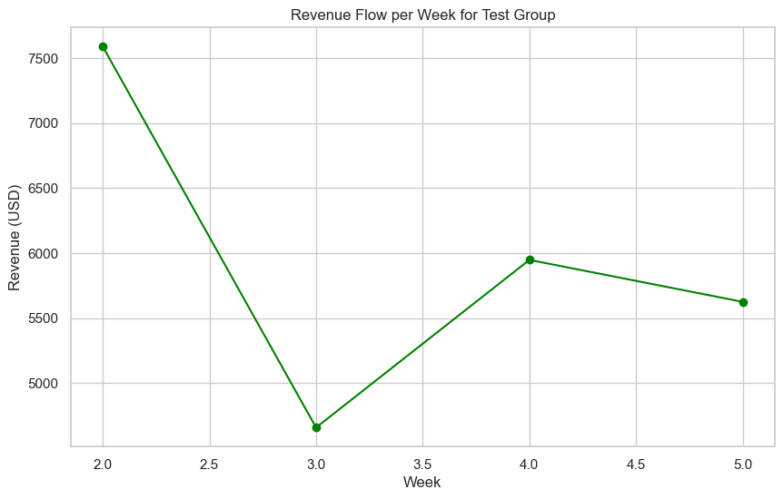
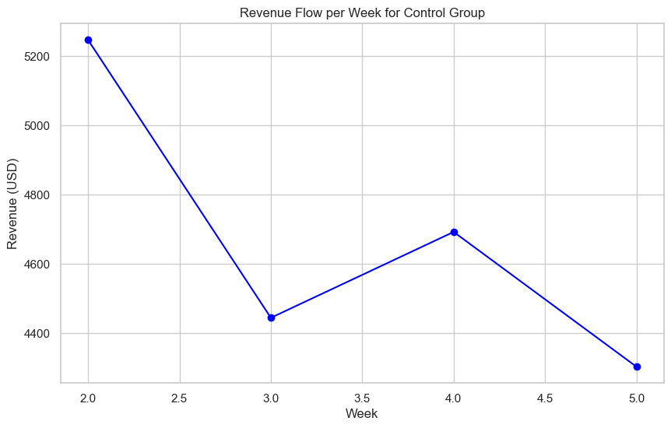
C. TIME INTELLIGENCE
Line plot was deployed to determine revenue flow on a weekly basis across the product pages.

Slide 7
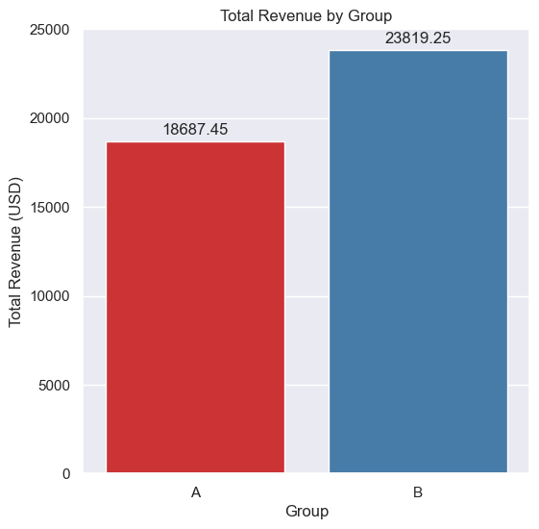
D. DESCRIPTIVE STATISTICS
Comparing difference in total revenue between control and test design.
As shown in the bar chart below, test design denoted by B has a total revenue of $23,819.25, while the control design has revenue of $18,867.45

Slide 8
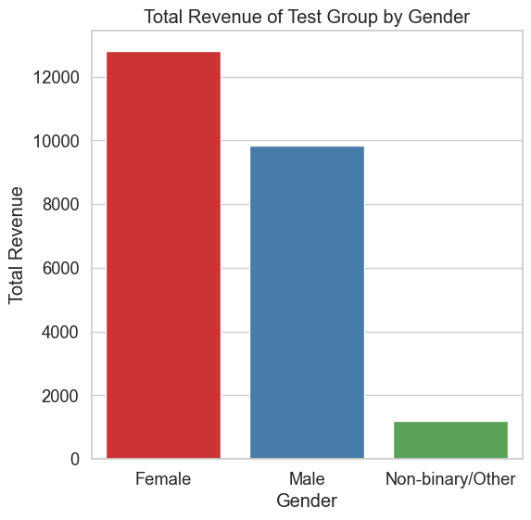
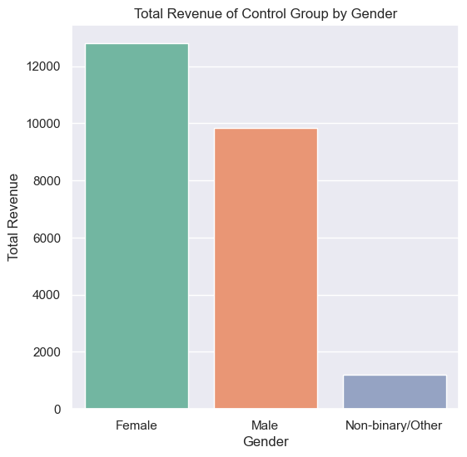
II. Comparing difference in total revenue by gender between control and test design.

Slide 9
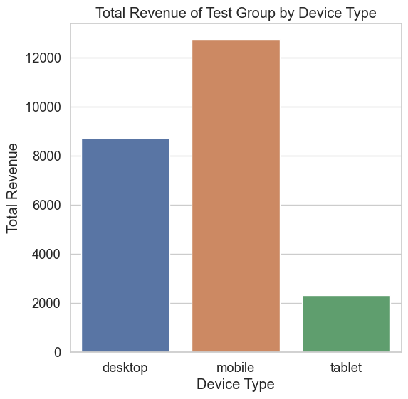
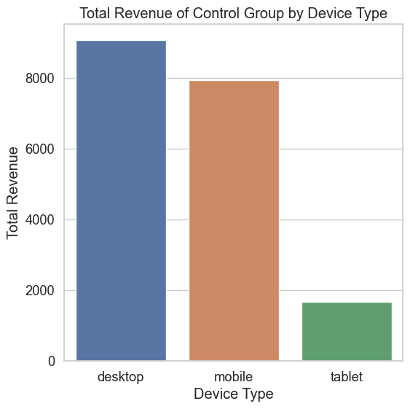
III. Comparing difference in total revenue by device type between control and test design.

Slide 10
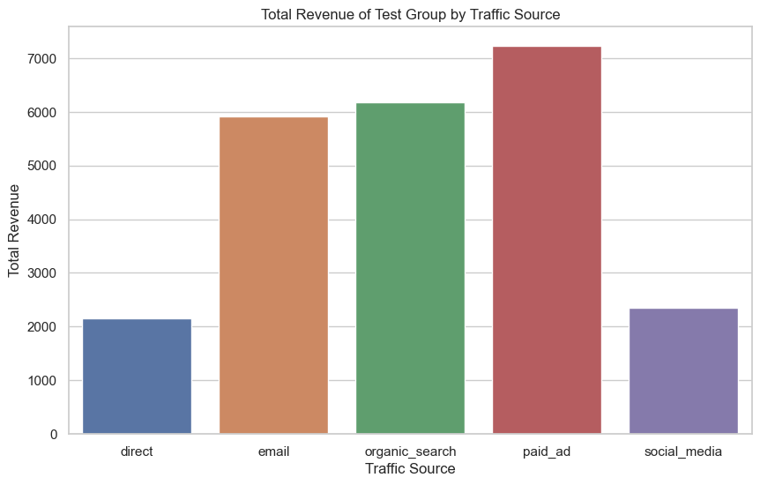
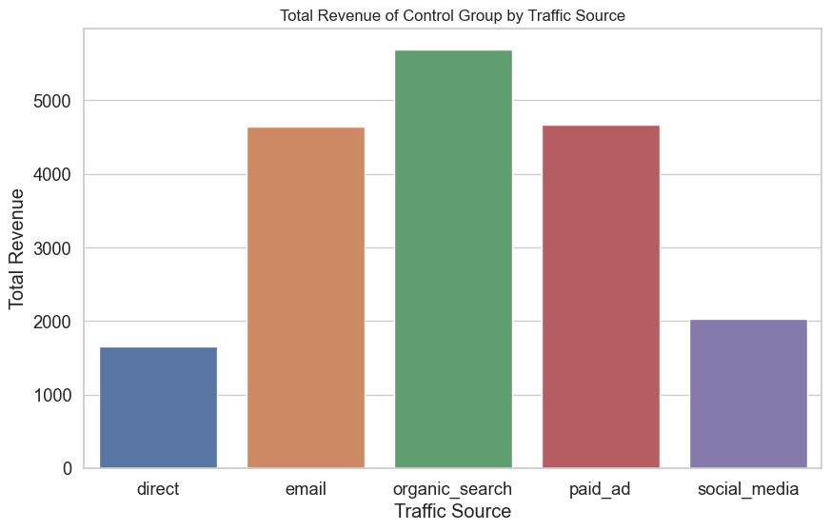
IV. Comparing difference in total revenue by traffic source between control and test design.

Slide 11
CONCLUSION AND RECOMMENDATION
The online retail store should progress in adopting the new test design since there is significant difference in conversion rate and total revenue.
The online retail store should increase mobile accessibility and features since there is greater revenue from mobile users as seen on page 9.
It was observed that revenue dropped from week 1-3, increased from 3 -4 and started declining from week 5 as shown in page 6. There is need for further analysis to determine factors responsible for fluctuations in revenue generated.

